Slide 1
Making Scientific Figures
“I think the fact that this author makes terrible figures has really hurt his career. He does brilliant work but it’s incomprehensible.” - Aaron Batista

Slide 2
Deciding how to present your information

Slide 3
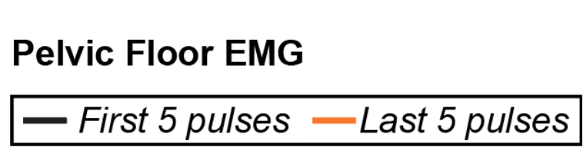
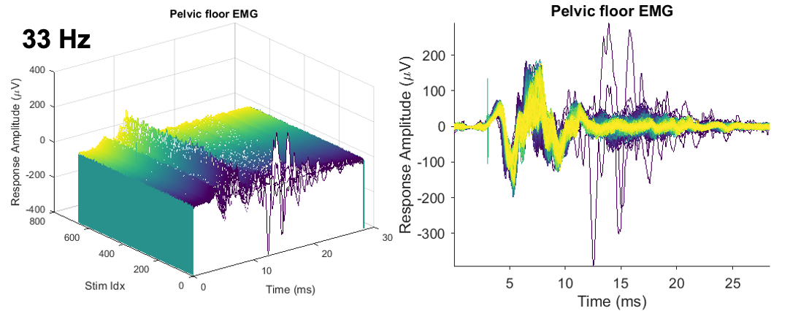
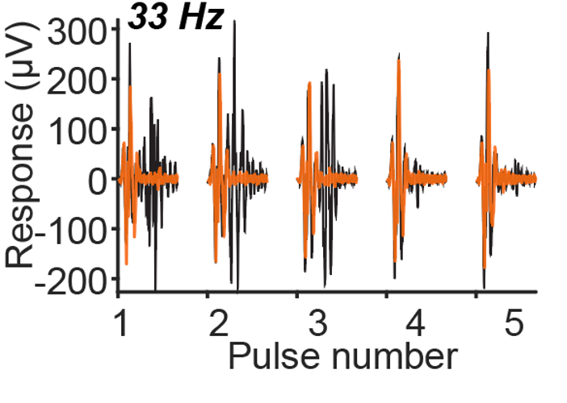
There are multiple ways to show the same data
Notes:
Key takeaway - Data from muscles while stimulating on the spinal cord. later part of response diminishes by end of stimulation train
Seeing every (600) response is actually distracting
Minimizing number of colors simplifies the plot and makes the difference stand out
Made the orange slightly transparent

Slide 4
What is the goal of your figure?
Identify your message!
What is your story? What does the reader need to understand your story?
If someone looks at the figure with no guidance, what do they think it means?
i.e. “The red bar is smaller than the blue bar,” vs “there are a lot of dots and lines.”
Can someone look at the figure and understand it without needing to read the entire paper?
Can you explain the point of the figure in one breath?
Only after identifying the message of the figure is it worth the time to develop it
Message trumps beauty
But often, a cleaner figure is better on both counts

Slide 5
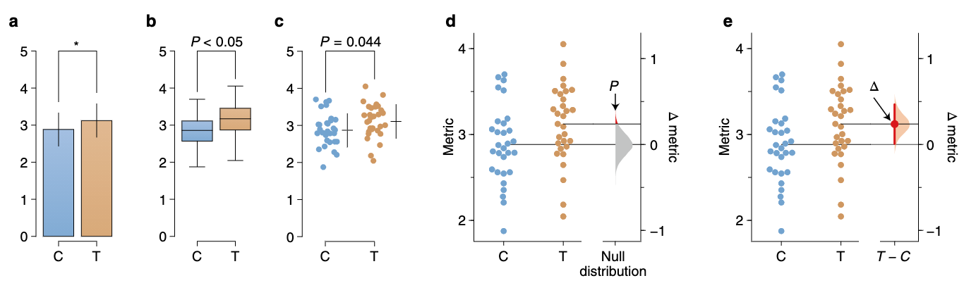
There are multiple ways to show the same data
Ho et al. 2019
Notes:
Build this up

Slide 6
There are multiple ways to show the same data
Ho et al. 2019
Notes:
Build this up

Slide 7
There are multiple ways to show the same data
Ho et al. 2019
Notes:
Build this up

Slide 8
There are multiple ways to show the same data
Ho et al. 2019
Notes:
Significance bar

Slide 9
There are multiple ways to show the same data
Ho et al. 2019
Notes:
Show effect size

Slide 10
Assessing data visualization
Good
= clear, informative, and aesthetically pleasing
Ugly
= aesthetic problems but otherwise clear and informative
Bad
= unclear, confusing, overly complicated, or deceiving
Wrong
= objectively incorrect

Slide 11
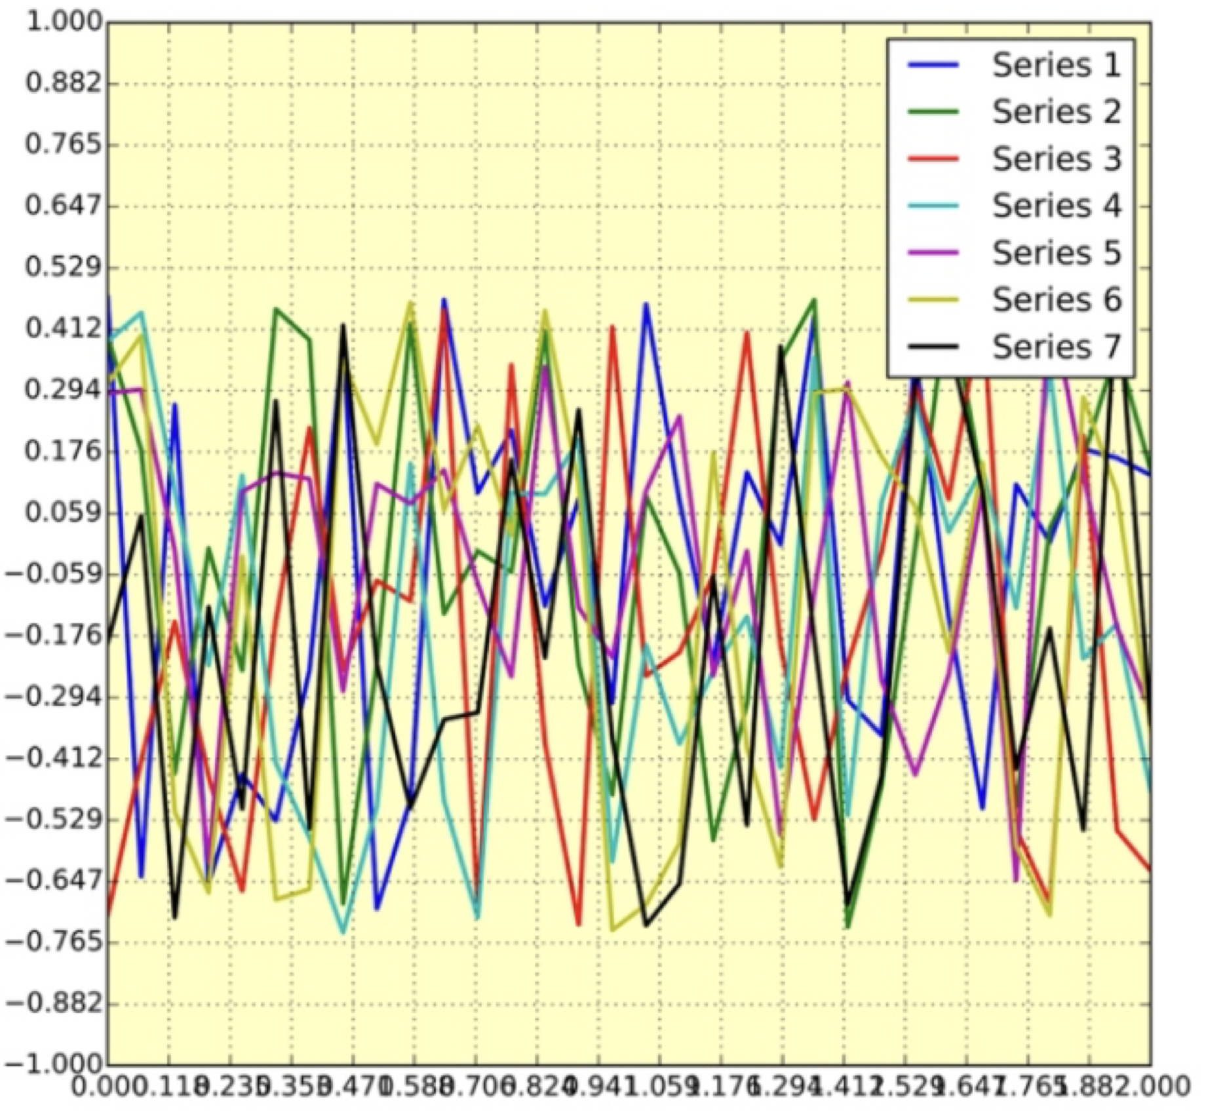
Is this figure good, bad, ugly, or wrong?

Slide 12
Bad- it is unclear and confusing

Slide 13
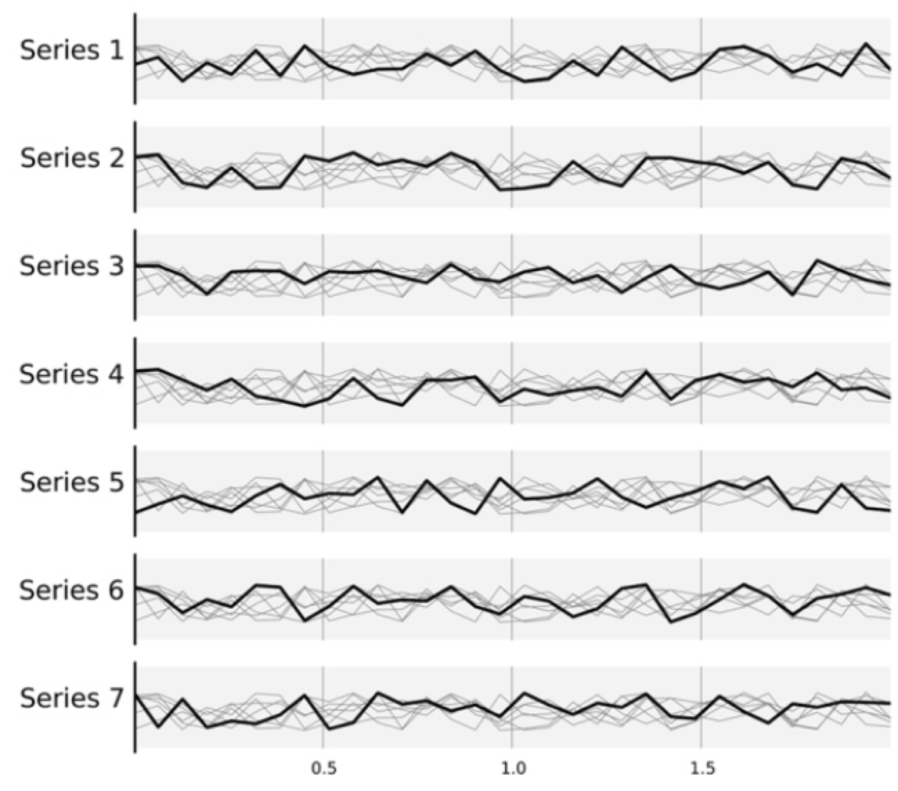
Better

Slide 14
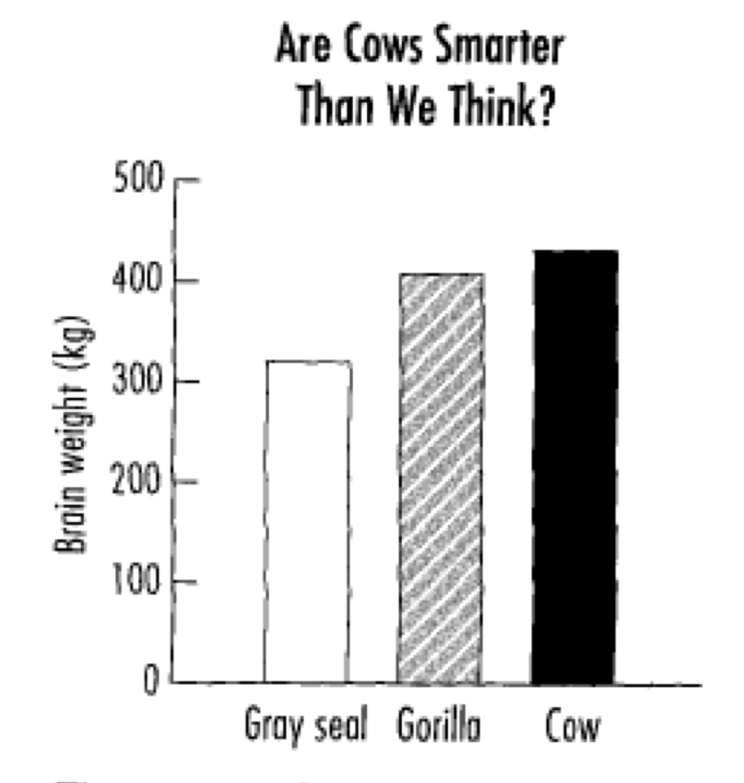
Is this figure good, bad, ugly, or wrong?

Slide 15
Bad- it is deceiving
Notes:
The progression from seal to cow looks inappropriately sharper when additional ink makes each bar increasingly salient.

Slide 16
Better

Slide 17
How much information to include in a plot?
Each figure needs to convey one central point
Provide enough information for the reader to understand
But not extra
Depends on the context in which you are presenting the information

Slide 18
Adapt the figure to the format
Is your audience likely composed of experts?
How long will they be looking at the figure?
Are you there to explain?
Paper/Poster
Typically in multiple parts
Contain more information
Presentation
Should include only a small amount of information at once: build up to your point
Very large labels
Grant
Should be very obvious from looking at the figure what your point is
Largely to illustrate that you are capable of carrying out work
Often preliminary data
In a fellowship, figures are not necessary but in some cases are helpful
Notes:
THINK ABOUT YOUR AUDIENCE

Slide 19
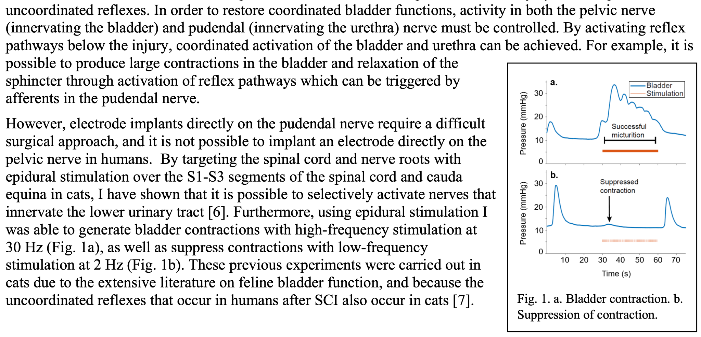
Idiot-proofing a fellowship figure
Notes:
Literally an arrow pointing to what I want the takeaway to be
Really simple concept (I can make the bladder contract with stimulation or relax with stimulation)
Large font sizes, legend.
Figures in a fellowship will be small
Generally, if you include a figure in a fellowship, it will probably be preliminary data (“Look, I’m so impressive” - especially if it’s still unpublished) but it’s important not to make it look like there’s nothing left to do

Slide 20
Choosing an order for figures
Figures:
Do you need to begin with a schematic before data?
Raw data first!
Summary data last
In a paper, the first couple of figures should highlight the key point
Panels within a figure:
Raw data first
Summary data last
Consider whether it is clear how the panels are related to each other
Build up
Compare/contrast
What is the goal of the figure?
Distinguish effectively between simulated data, types of animal tested, manipulations

Slide 21
Making an effective schematic
Simple
Convey a high-level idea
Prepare the reader for the data they are about to see

Slide 22
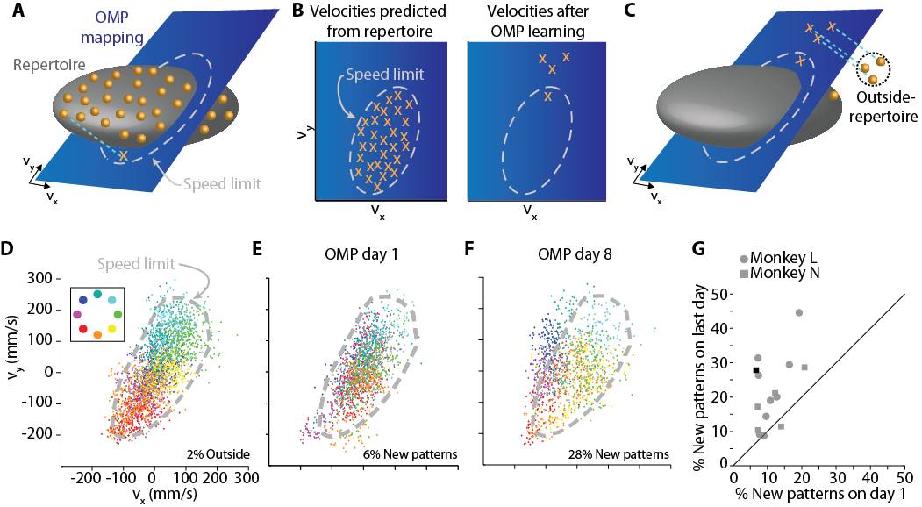

Slide 23
So you have a figure...

Slide 24
Essentials for every figure
Axes and units
Legends vs labeling lines
Choosing a title
Include as much of this as possible in the code that generates your figure
Export as a vector graphics file if possible (scalable, not pixels)
.EPS, .PDF
Absolutely not as a .JPEG
Assume you will need to make some edits in software such as Adobe Illustrator or Inkscape
Alignment, coloring, font size or type

Slide 25
Design choices: Don’t use the defaults
Multi-part figures
Style of plot
Marker shape and size (easily distinguishable)
Box on/off
Consistency
Off
Tick mark direction and frequency
Consistency (MATLAB auto-sets these differently in different plot styles)
Out
Grids
Off
Color
Everyone knows the MATLAB default colors so they’ll notice if that’s what you use
Notes:
Default differences in matlab and python
Tick frequency and size should be matched to font size for a given presentation style

Slide 26
Use color effectively
Color is an important dimension in figure design
Does color add anything?
If not, keep it black
For an enhancing effect, use color for one element while keeping other elements gray or black
Avoid using too many similar colors since color blindness makes it difficult to discern some color differences
Transparency can help or hurt

Slide 27
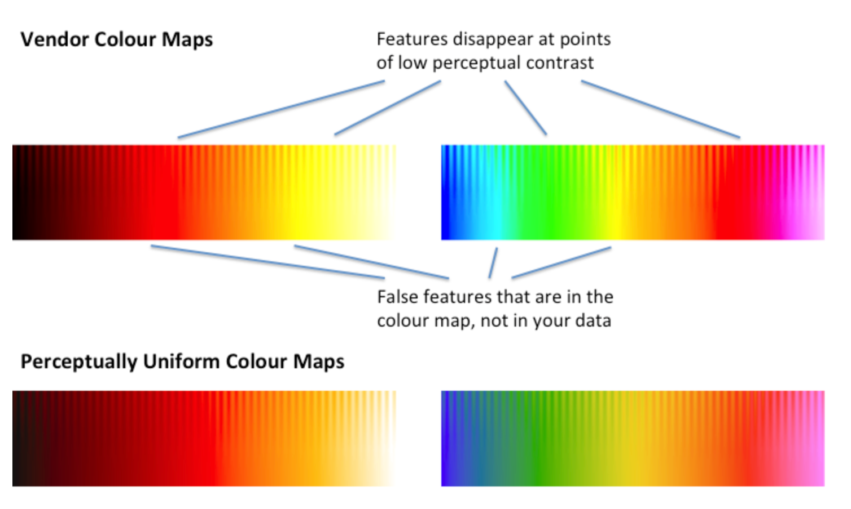
Colors and the tools to choose them
Are they colorblind-friendly?
What if someone has a bad printer or only a grayscale printer?
Consistency throughout paper/presentation
Artifacts in certain colormaps
Tools:
Viz Palette
ColorBrewer
Colorgorical

Slide 28
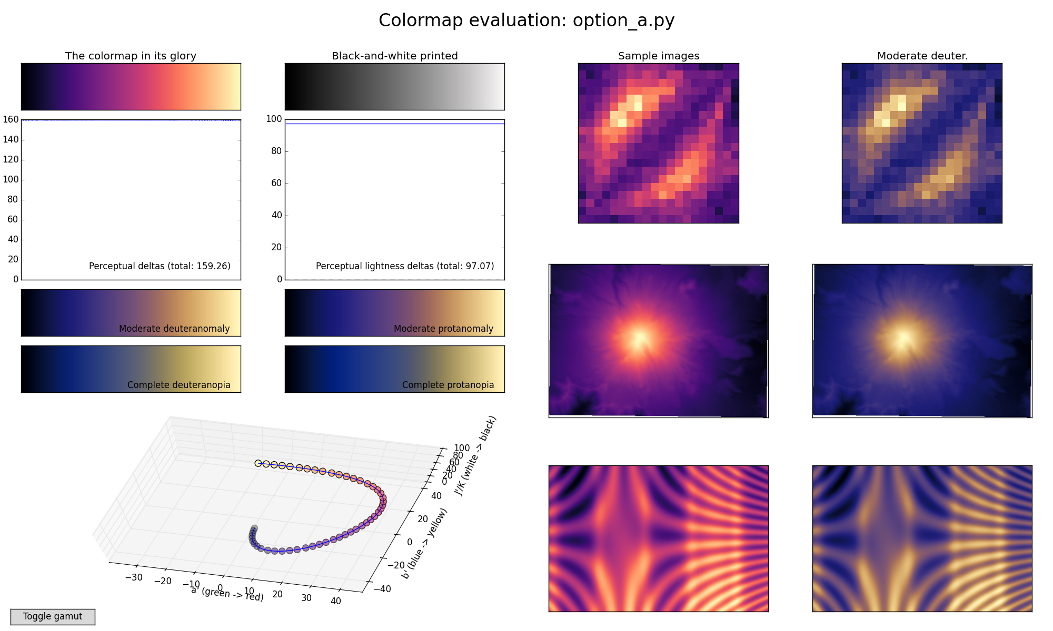
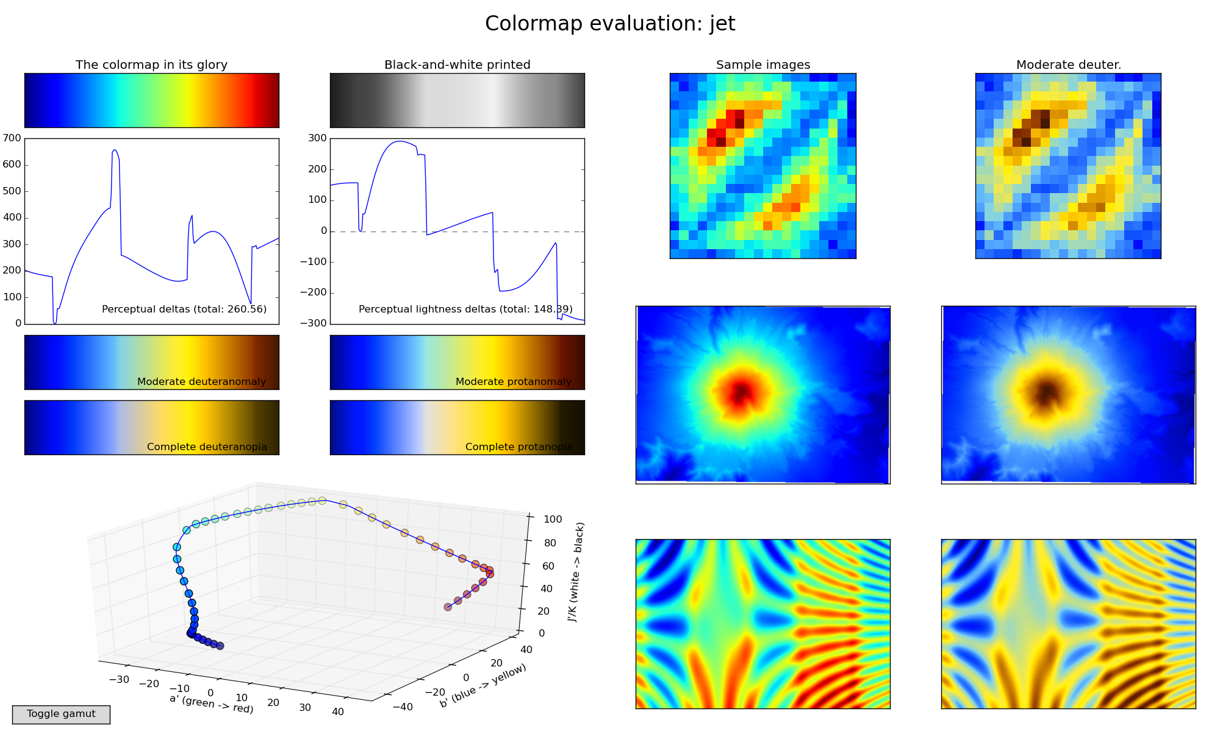
Colors and the tools to choose them
Are they colorblind-friendly?
What if someone has a bad printer or only a grayscale printer?
Consistency throughout paper/presentation
Artifacts in certain colormaps
Tools:
Viz Palette
ColorBrewer
Colorgorical
Notes:
With non-uniform maps there are scenarios where they’re useful (for example, trying to highlight a specific feature in MRI data) but you need to KNOW that this counts as manipulating data (basically a visual filter)

Slide 29
Captions
The bolded title of the figure should be the take-away point of the figure.
Avoid excessive redundancy between the caption and the figure, or the caption and the text
BAD: “The x-axis is the time course of the signal.”
USEFUL: “As an example, at the point (x, y), the signal is…”
Just enough information for the reader to understand

Slide 30
Workshopping a good figure

Slide 31
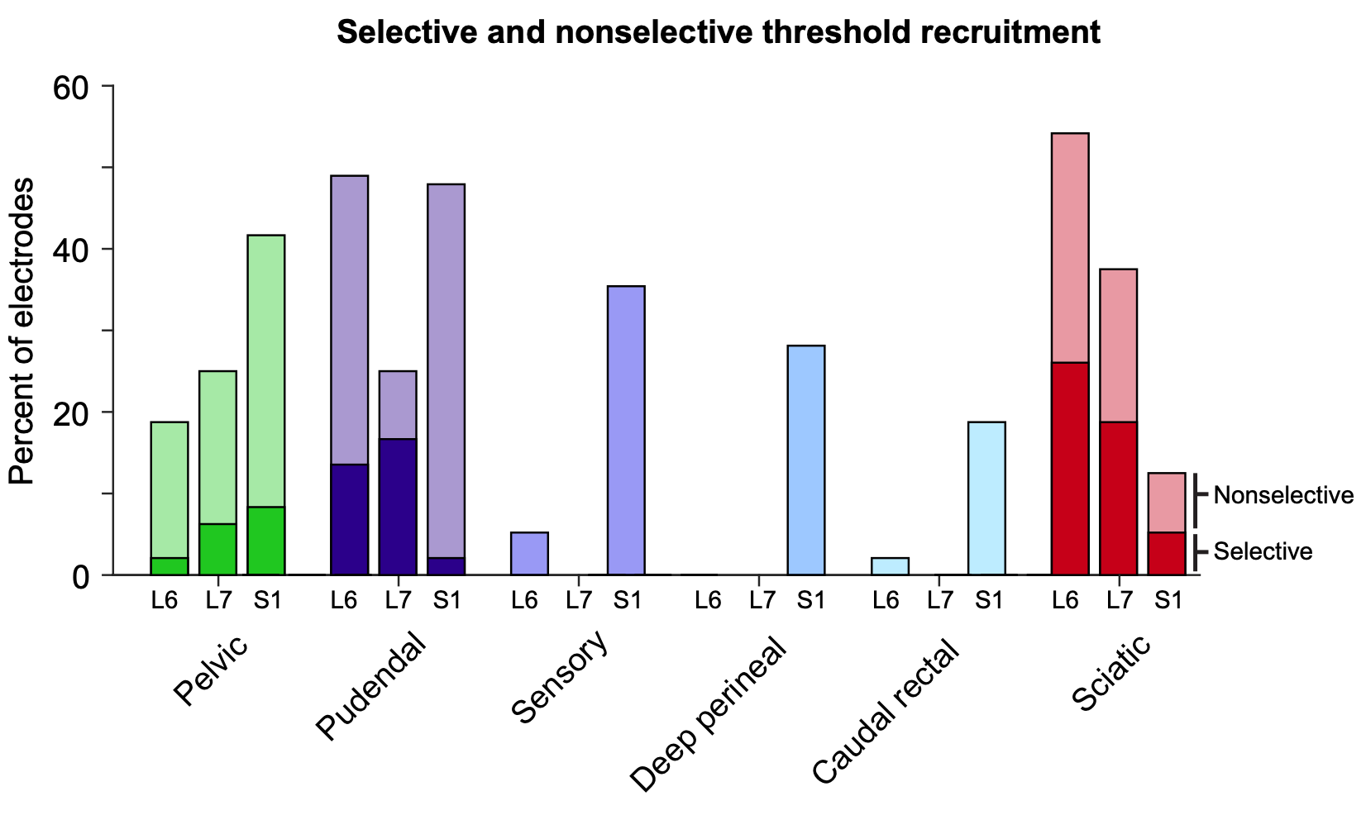
Final paper figure
Notes:
The main point is:
Three nerves are the main ones we saw respond to this intervention (pelvic, pudendal, sciatic)
Testing at different locations (L6, L7, S1) makes different things happen

Slide 32
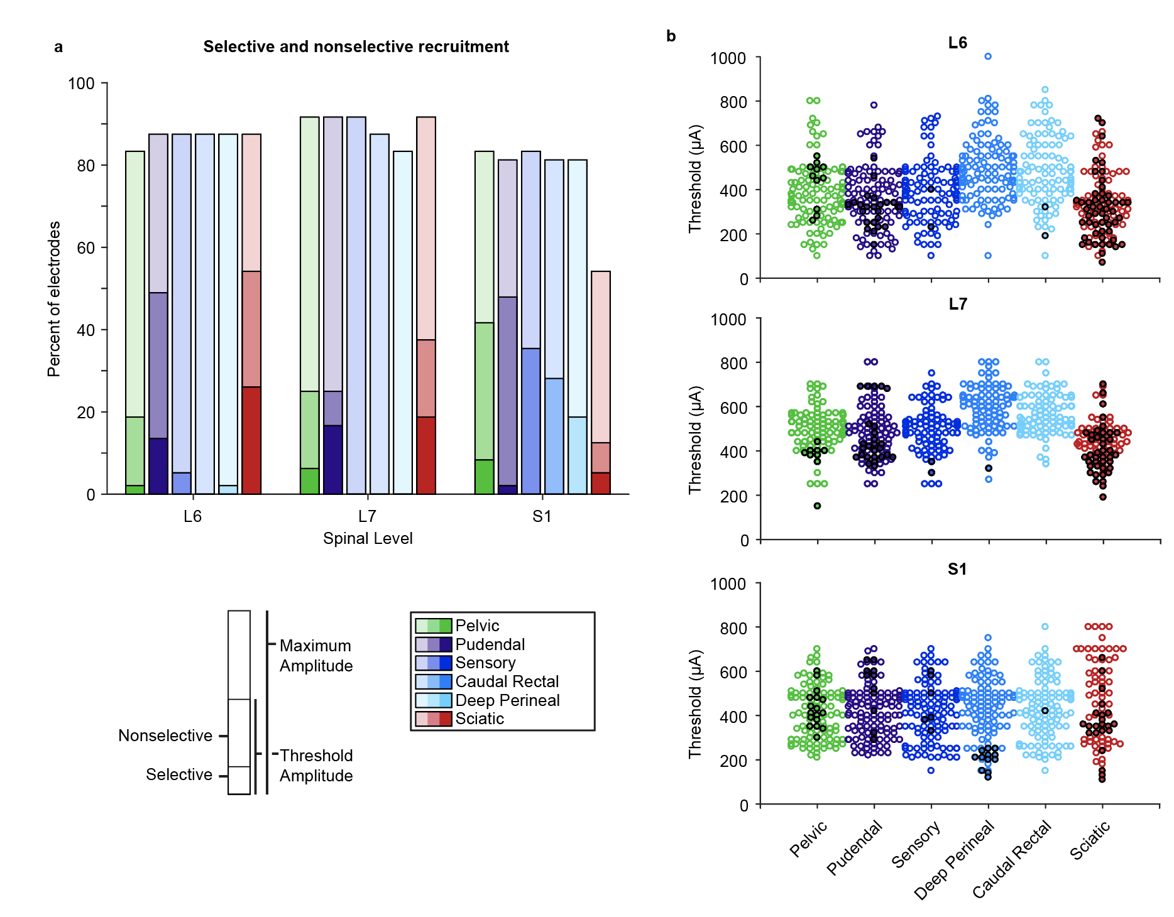
Original figure
Notes:
What is the main point?
-- note this includes raw data - B is raw data and I did put that panel as part of the figure right before this
Third group of data that we decided was not as important to our story (got rid of faded bars)

Slide 33
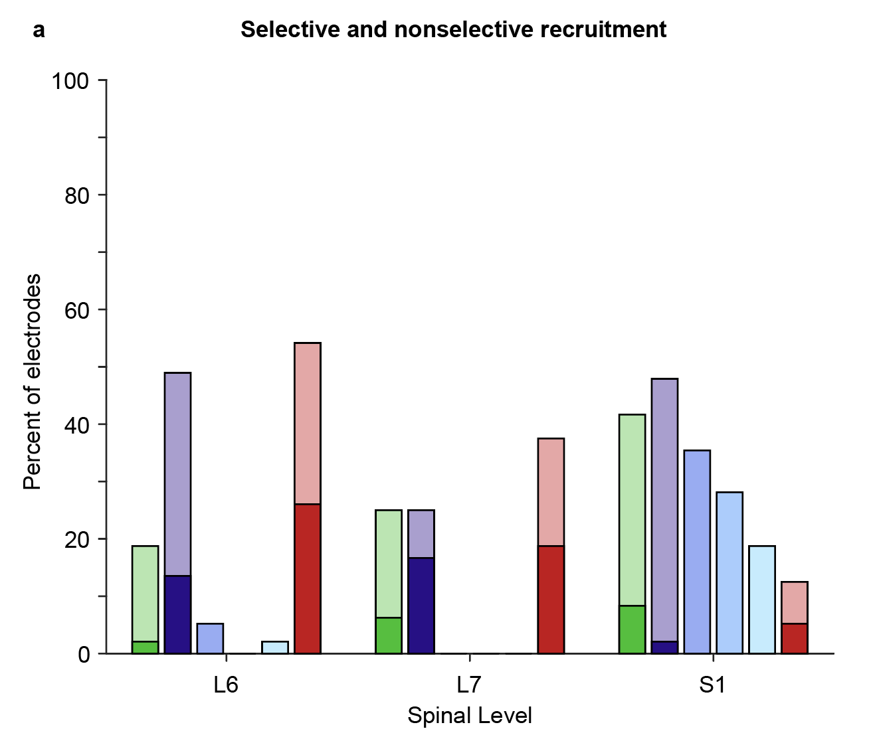
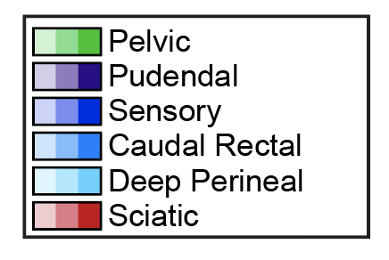
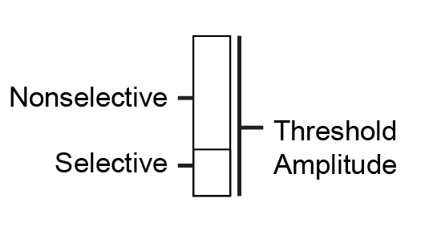
Original figure without max amp

Slide 34
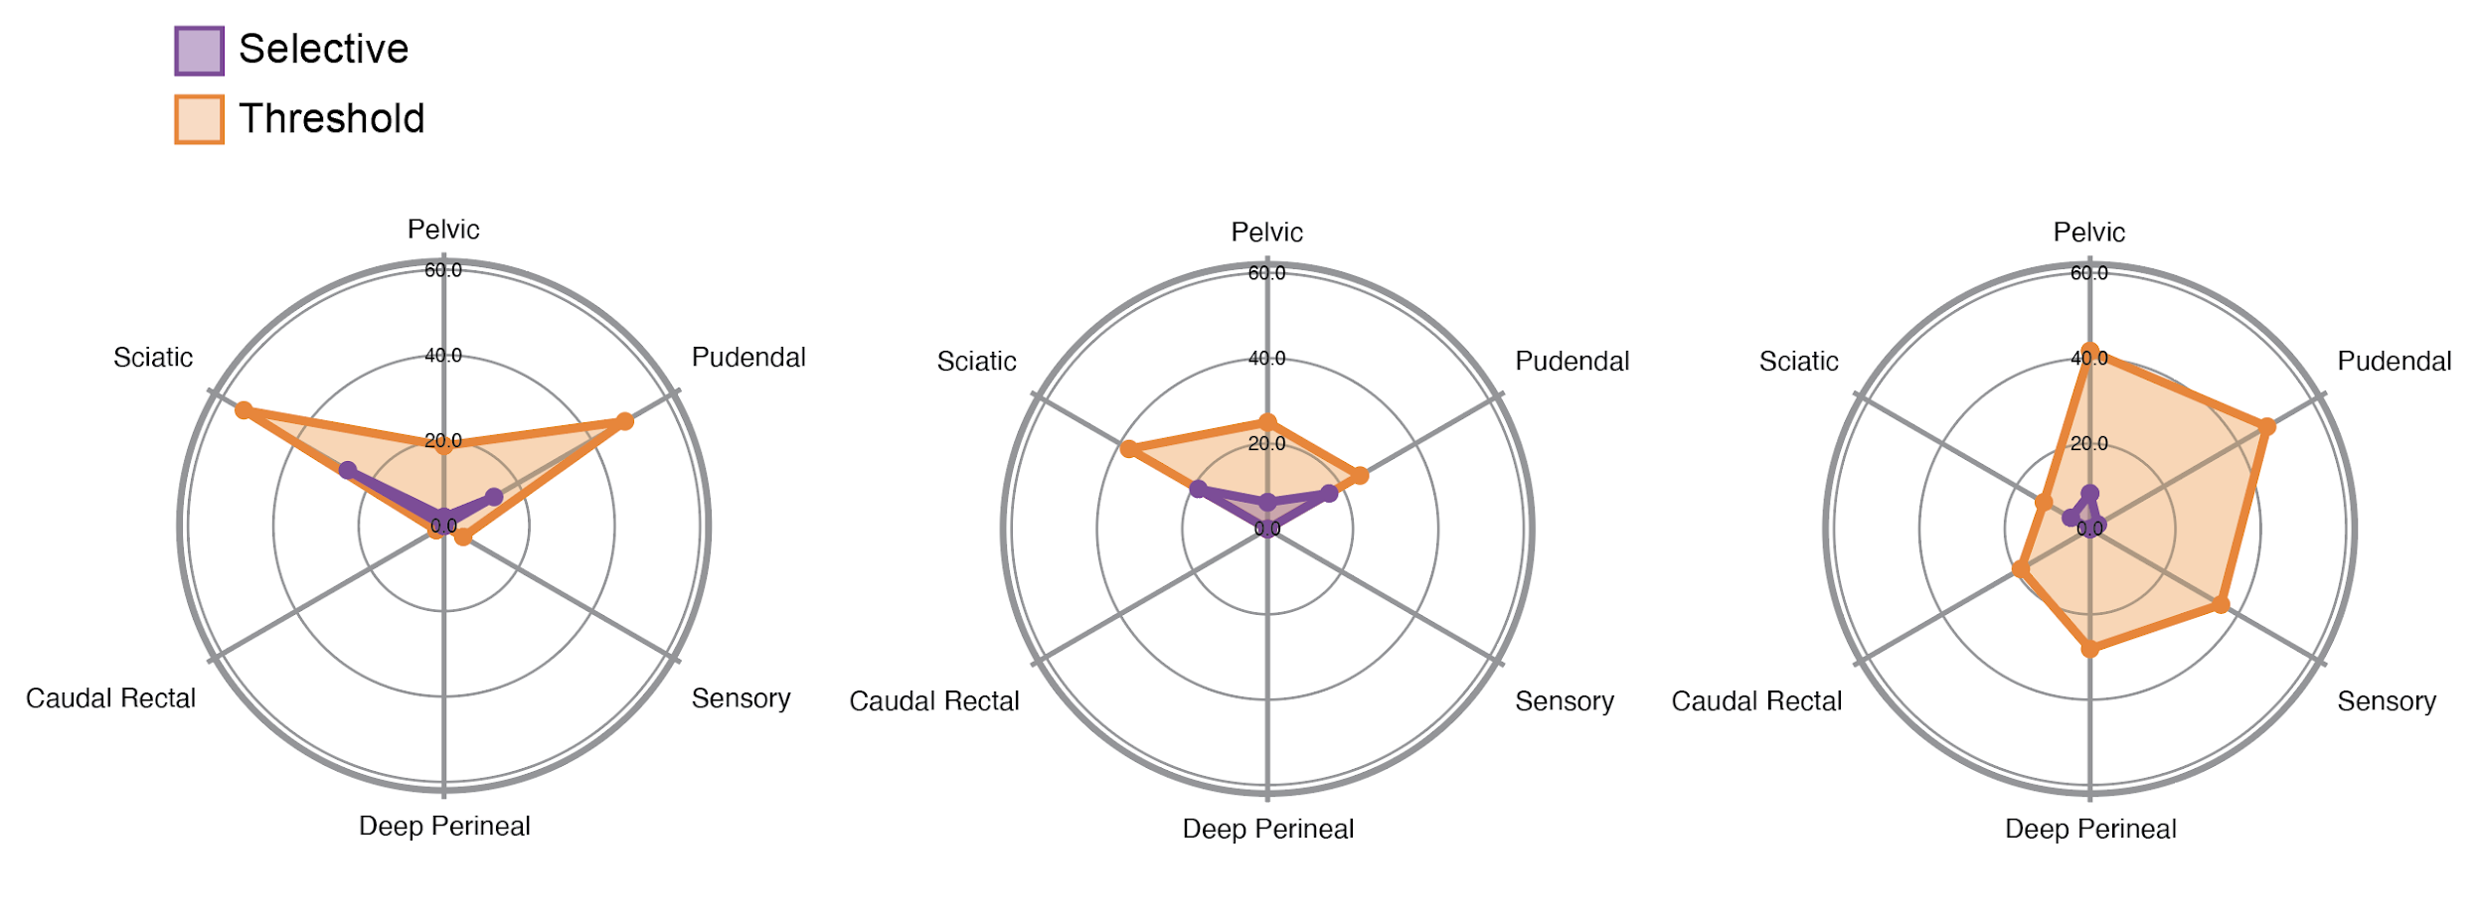
Radial plots: By level
L6
L7
S1

Slide 35
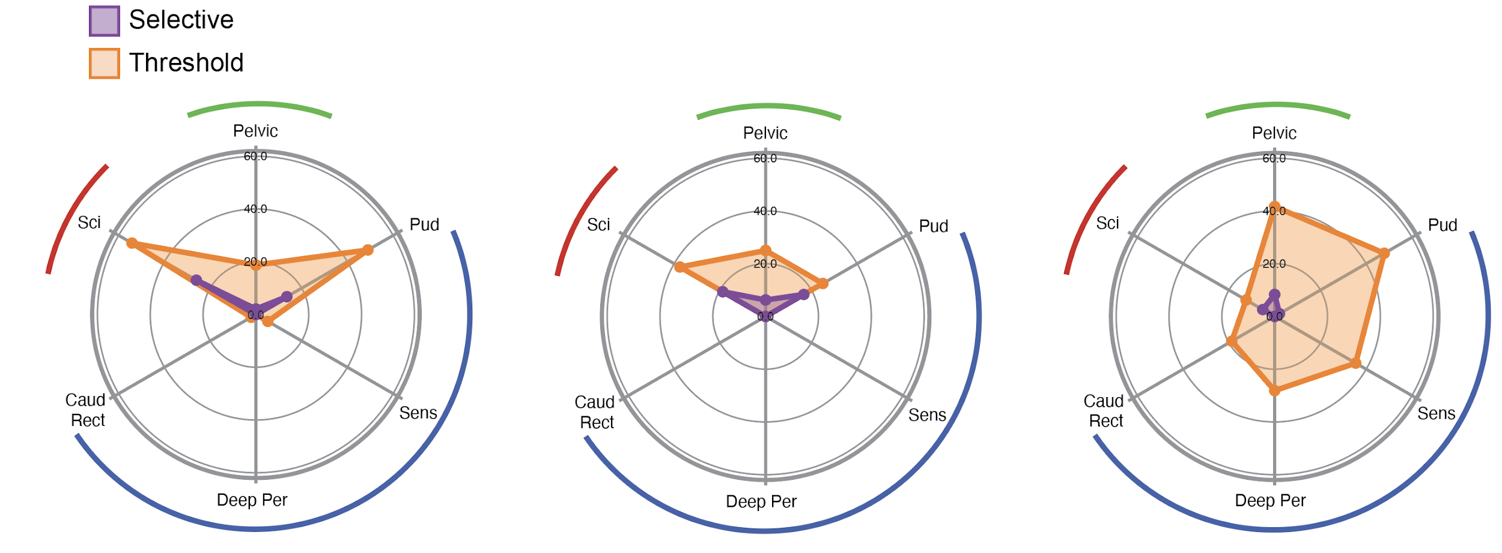
Radial plots: By level
L6
L7
S1

Slide 36
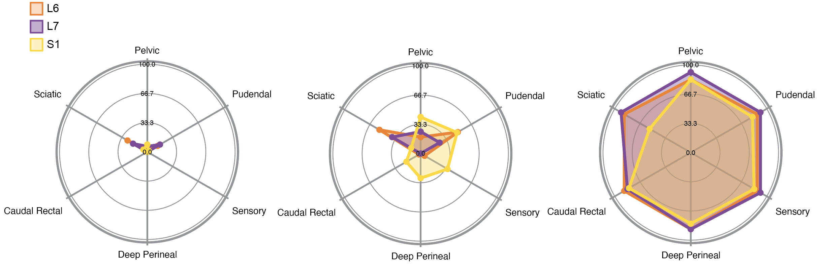
Radial plots: By recruitment type
Selective
Threshold
Maximum
Amplitude

Slide 37
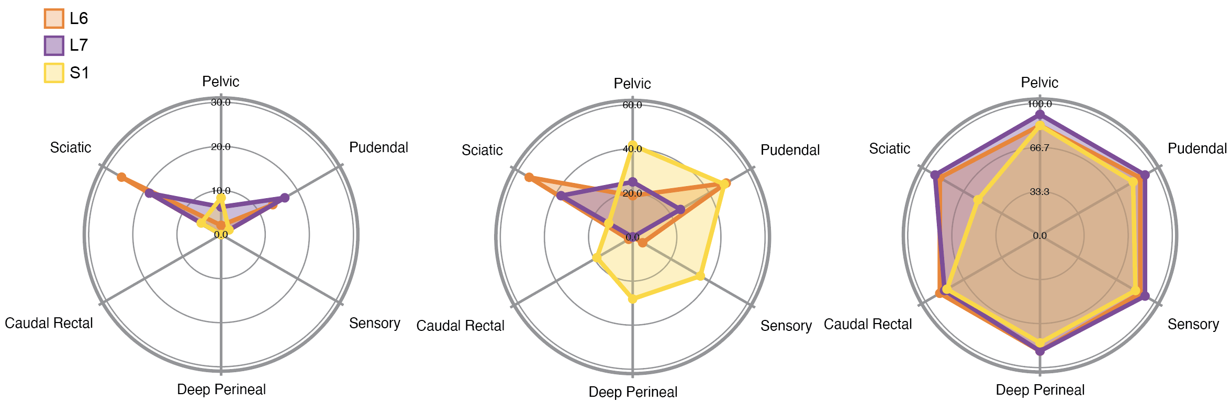
Radial plots: By recruitment type (scaled)
Selective
Threshold
Maximum
Amplitude

Slide 38
Final paper figure

Slide 39
Further reading
Ten simple rules for better figures
Details to ensure figure quality
Many types of plots and composition
Nature Points of View columns on figures and design

Slide 40
With the plots you brought
Groups of 4 or fewer; spend about 3 minutes on each figure
Can someone look at the figure with no guidance and tell you what it means?
Pass your figure to the person on your left and have them describe what your figure is showing
Does it communicate the main idea?
Describe what it is actually showing in one breath
Discuss:
Is it aesthetically pleasing?
Is there extra information?
What could be changed to make it clearer?
Notes:
Wrap up: Review form will be sent out - CRITICAL to do those because next class will be all discussion of these proposals - we’ll also have everyone show up to different rooms.

